Slide 1

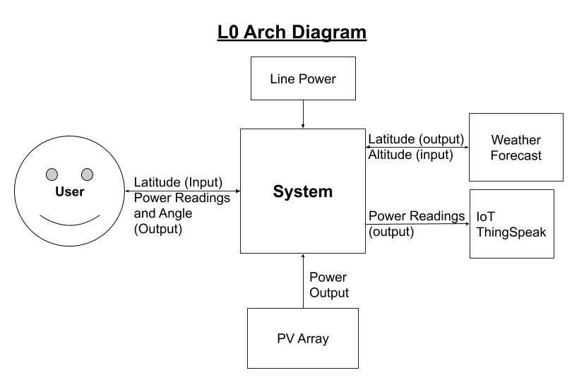
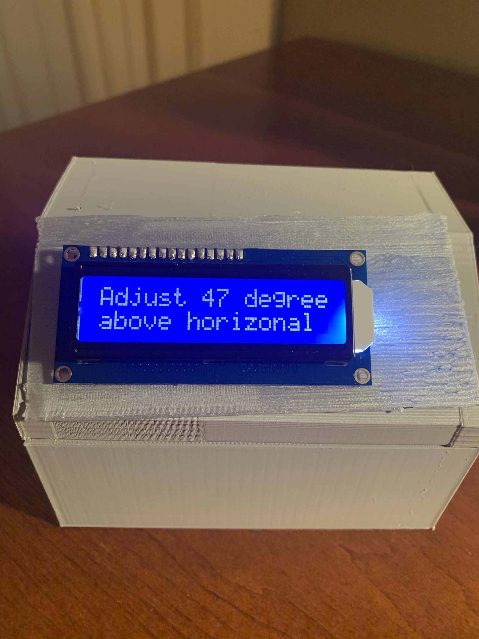
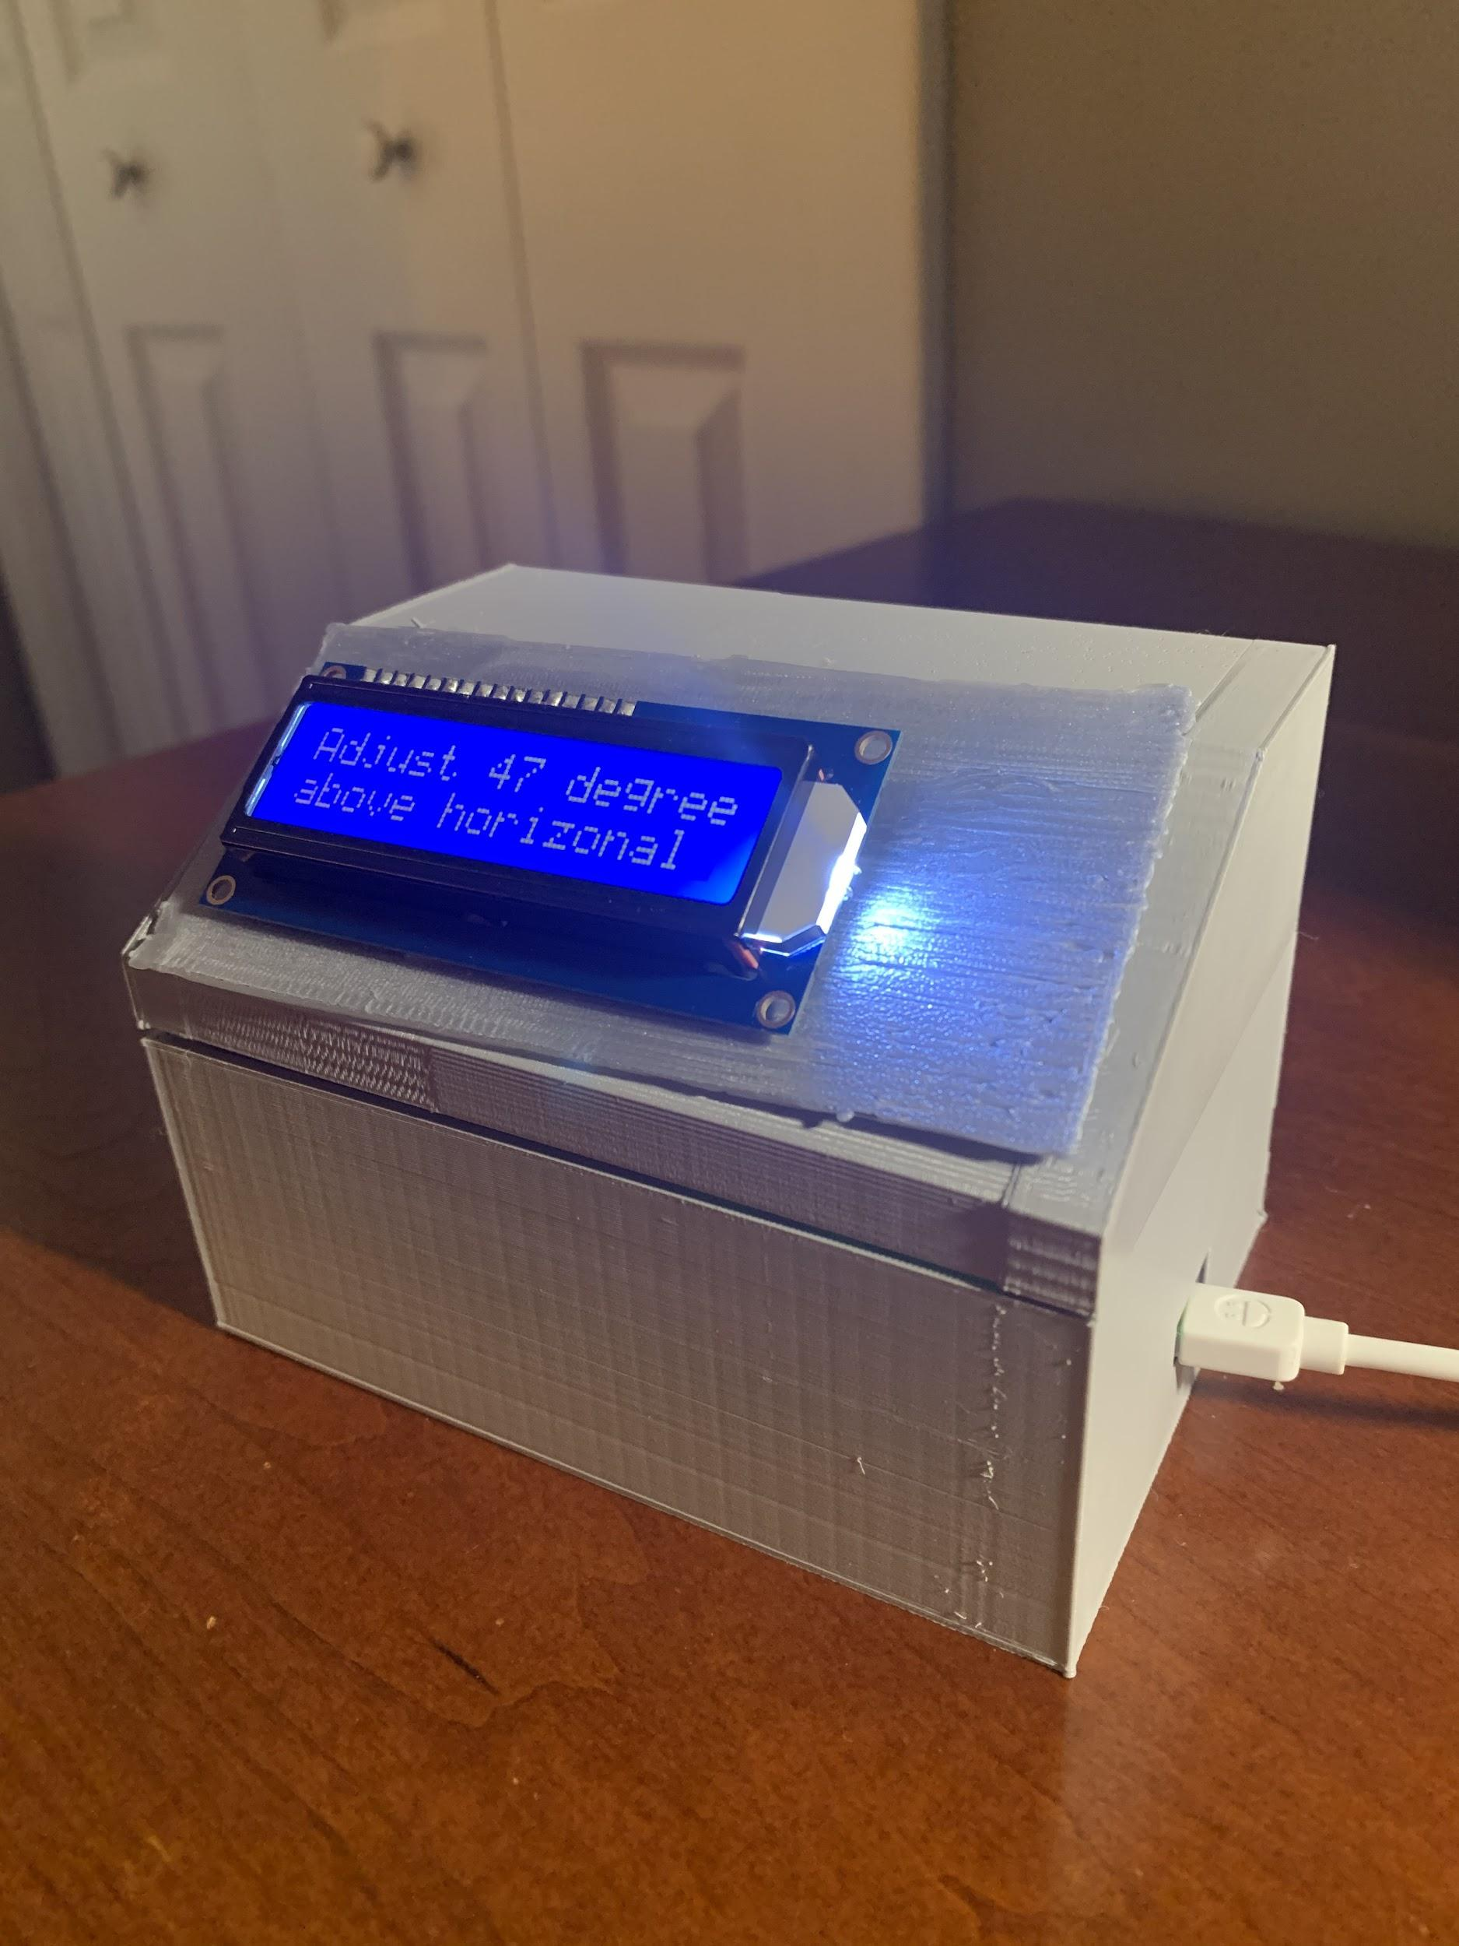
Manual Solar Panel Sun Tracking
Rachel Cherrey, Christian Sieck
Brandon Martinez, Michael Gertz
Bucknell University, Electrical & Computer Engineering
Our Project Goal:
Improve the efficiency of solar panels by providing users with the optimal angle to adjust the panel based on a given location, in efforts to make solar panels more economical.
Project Scope & Value
Our Project was designed to help a homeowner who has solar panels installed on the ground. We focused in on a household in the midwest. Our value comes from improving the efficiency of the panels to more power can be produced without installing additional panels.
Project Function
Our device takes an input from the user that is their current location. Then, after some computations are made on a microcontroller, the optimal angle to position a solar panel is displayed on the LCD panel. Then the power captured by the solar panel is reported to the internet for the user.
Figure 1: L0 Architectural Diagram of System’s Behavior Figure 2 & 3: Final System Displaying Angle of Adjustment
Technical and Non-Technical
Design Aspects
Technical:
Voltage and current output of solar panel
Programming code for power readings, tilt degree, and LCD display
Wiring for LCD display and solar power measurement
Space dimensions for the physical system
Non-Technical:
Access to data using the internet
Location of the user and the system
Adjustment to the solar panels
Frequency and duration of uploading data
Source for desired tilt degree
Tests & Results
Two distinct types of tests were performed on our system: physical and behavioral.
Physical: System is able to withstand being jostled.
Behavioral:
System is able to calculate and display the correct angle to move the solar panel to maximize power.
System is able to report power output values to Thingspeak per minute.
Future To Do Items
Altering the manner in which current altitude is determined to incorporate more input data for more accurate angles.
Improve power generation measurement accuracy for PV.
Make enclosure larger so components fit more neatly.
Major Accomplishments or Conclusions
System is able to determine the angle to tilt solar panel to maximize energy output, which is displayed to the user.
Power readings sent to the internet, observable by user
Our system might provide more value to a user as a purely software implementation
Acknowledgements
A special thanks to Professors Amal Kabalan and Peter Jansson, as well as Marc Del Vecchio for taking time for use to interview them throughout the semester. Also, Professor Stu Thompson for guiding our team throughout this process.

